Slide 1
Mobile Application for Personal Diabetes Management
Modules and Architecture

Slide 2
Modules of the Application
Medical Records Logging
Personal Assistant
Progress Tracking
Patient – Practitioner Communication
Notifications

Slide 3
Medical Records Logging
Entry of medical data such as
Blood Sugar level
Insulin dosage
Weight
Blood pressure
Cholesterol
Ketones
HA1C

Slide 4
Personal Assistant
Guidance tips and education on diabetes
Preferred diets and exercises
Location of nearby hospitals using google maps
Medications management

Slide 5
Progress Tracker
Displays medical data such as glucose level, blood pressure, HA1C using charts
Displays progress bar indicating progress level of patient

Slide 6
Patient – Practitioner Communication
Drug prescription by practitioner
Chat communication between patient and practitioner

Slide 7
Notification
Patient and practitioner are notified when patient fails to log records
Patient and practitioner are notified when progress levels drop below normal
SMS is sent to when app is offline

Slide 8
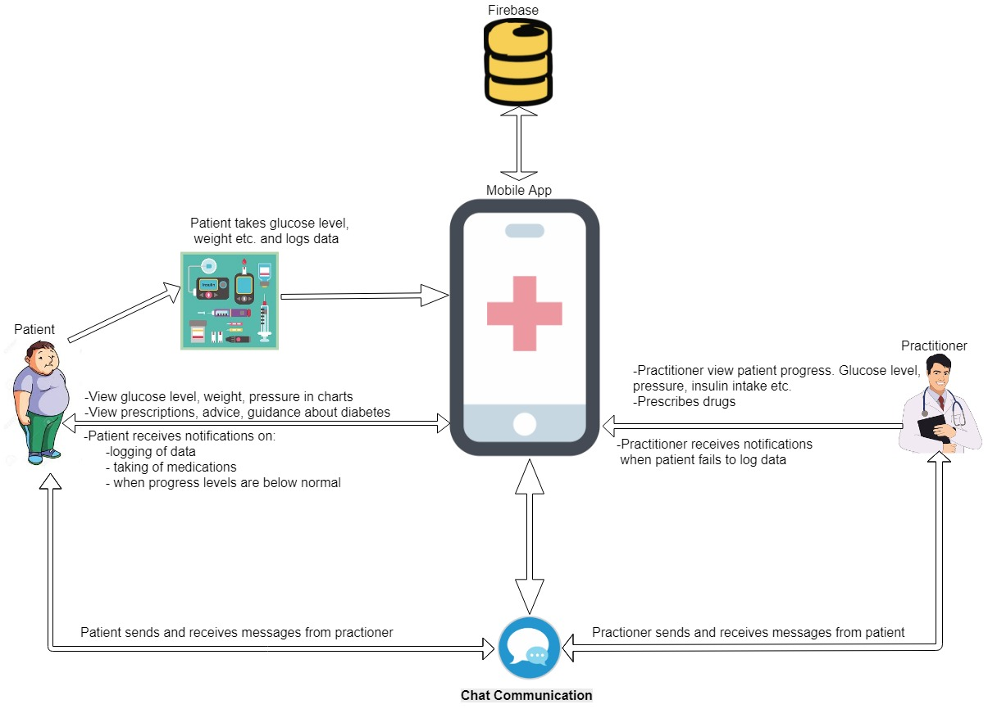
Architecture

